Slide 1
Title IX @ Tulane: Your TA/GA Responsibilities
Meredith Smith

Slide 2
Why and What
Notes:
So when we learn about these incidents, what is Tulane’s duty?

Slide 3
What is Title IX?

Slide 4
What is Title IX?
Sexual Discrimination
Sexual Harassment
Sexual Violence
Notes:
Title IX has a series of umbrellas: biggest is sexual discrimination. Then sexual harassment is another umbrella. Sexual violence is our last umbrella.

Slide 5
Sexual & Gender-Based Harassment
Sexual Harassment
Gender Based Harassment

Slide 6
Support at the University
Notes:
So when we learn about these incidents, what is Tulane’s duty?

Slide 7
Remedial Measures
Safety Measures
Housing Changes
Academic Measures
Disciplinary Process
Educational Programming
Support & Advocacy
Interim
Permanent

Slide 8
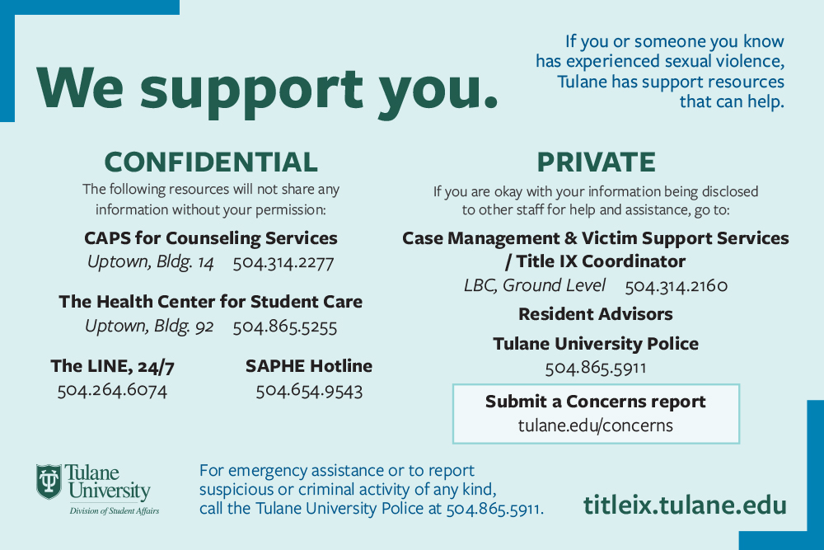

Slide 9
Reporting
Notes:
So when we learn about these incidents, what is Tulane’s duty?

Slide 10
Reporting Form
Notes:
504-920-9900

Slide 11
Report is received through
Tulane.edu/concerns
Routed to CMVSS,
Assigned to a case manager;
TIX Coordinator sees report
CMVSS reaches out to reported victim;
Student can choose to respond
If student agrees, CMVSS & they meet;
Student told about resources, Conduct process, criminal process

Slide 12
To Sum Up…
Notes:
So when we learn about these incidents, what is Tulane’s duty?

Slide 13
Receiving Reports
Sexual harassment and violence is not tolerated at Tulane.
If you experience this behavior, you have a lot of support options.
Push back against sexism and homophobia!
TULANE.EDU/CONCERNS
SAPOC: 504-920-9900

Slide 14
Thank you! Questions?

